Slide 1
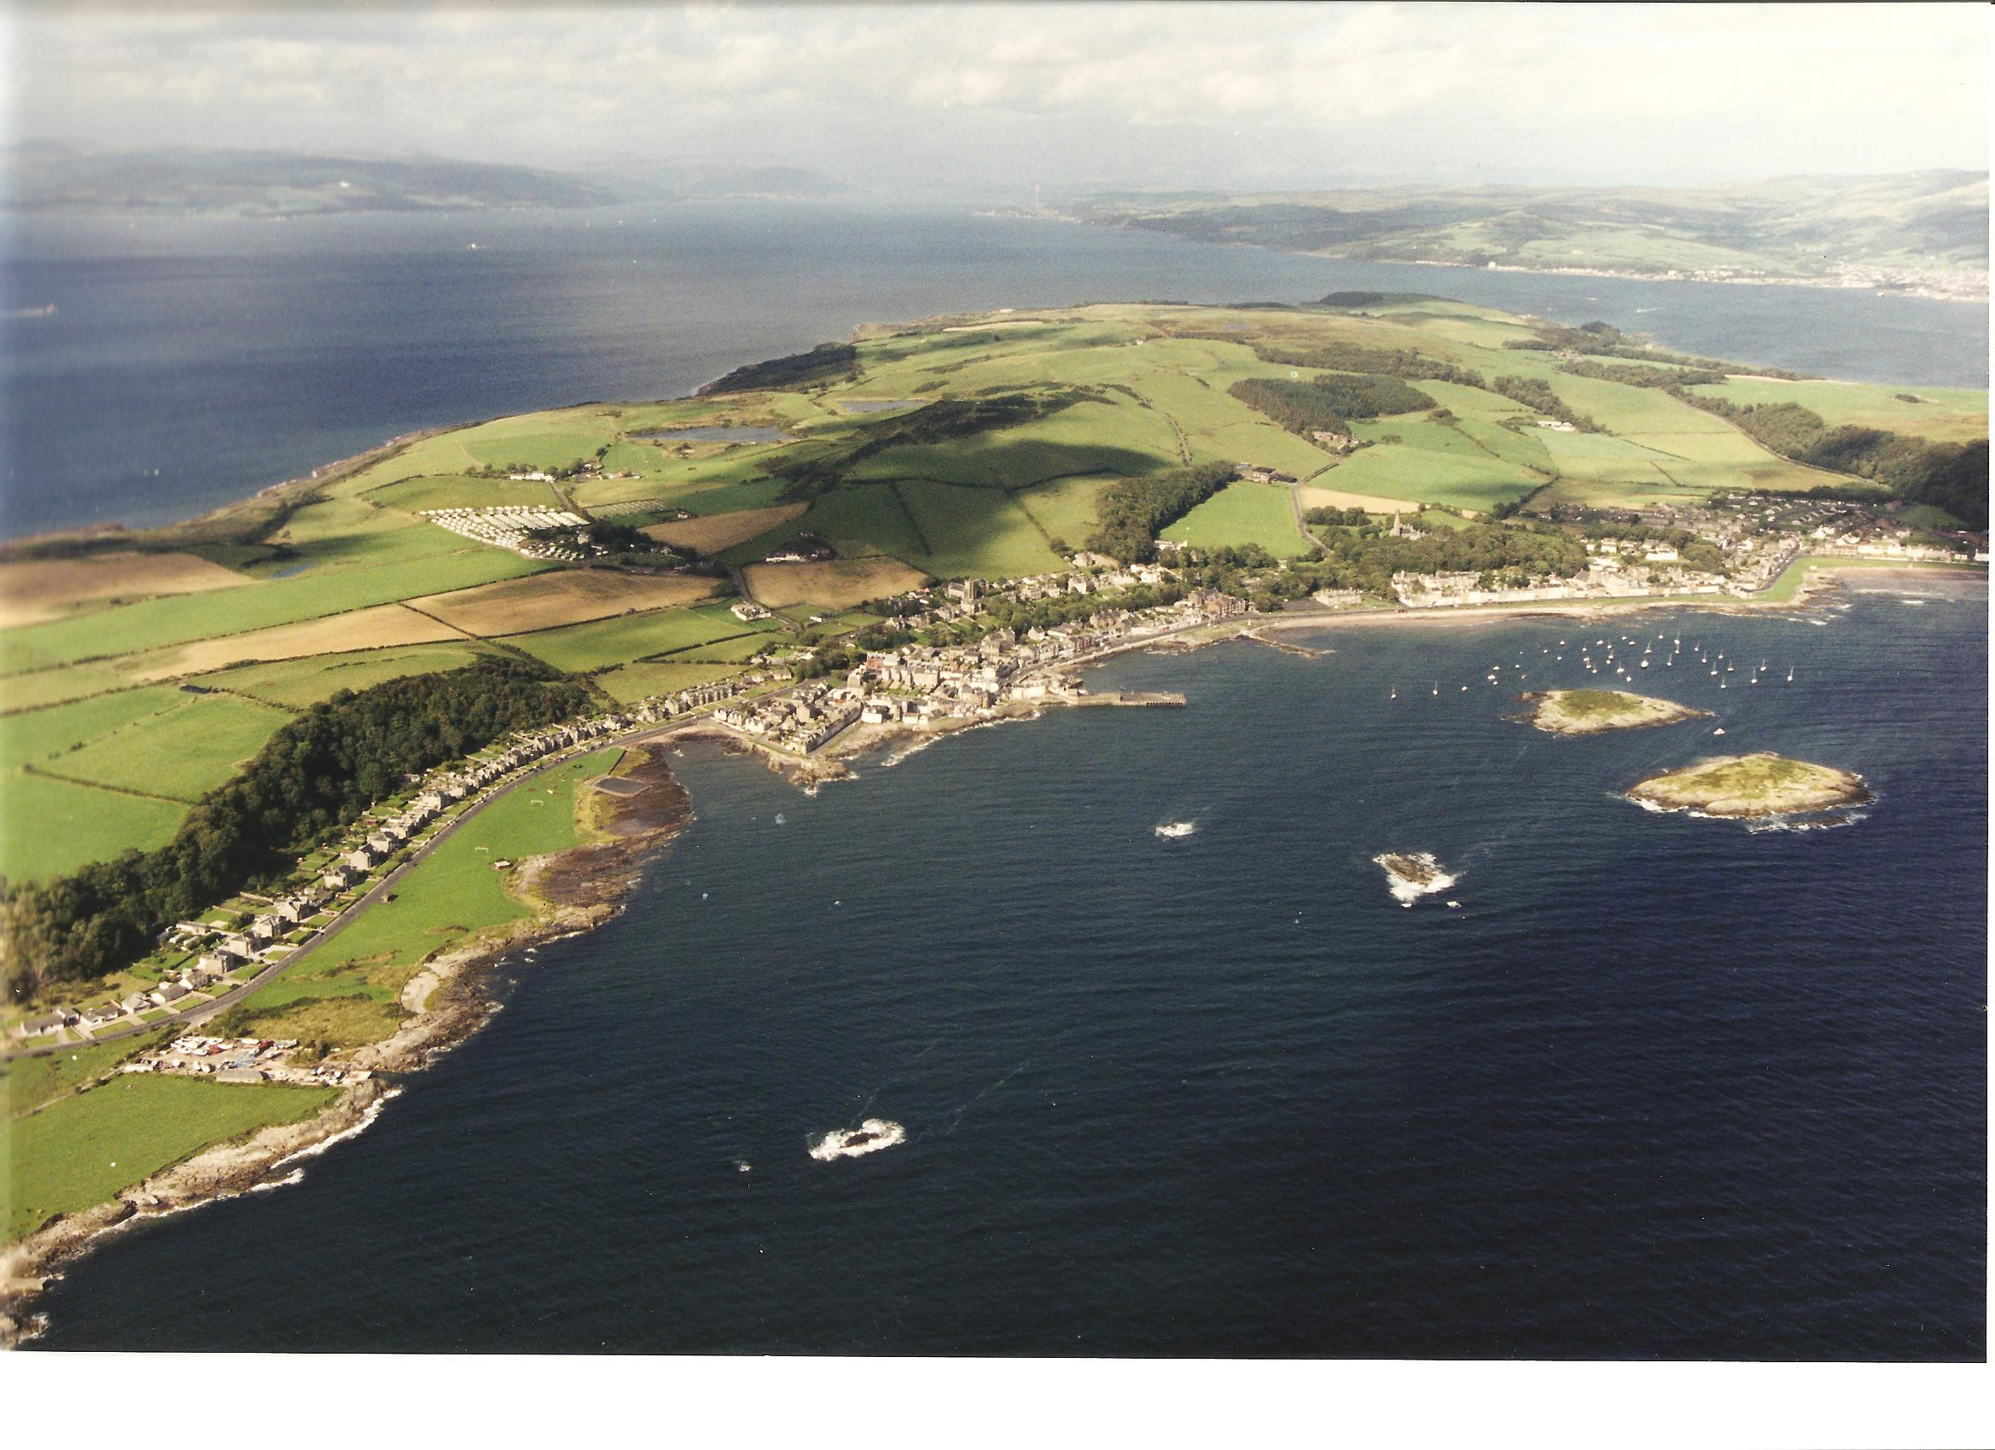
Cumbrae Community Council
Community Consultation
2018

Slide 2
Purpose of the Consultation
If Community Councils are to fulfill their statutory purpose, it is vital that they consult as fully as possible with the local community, and give local people the opportunity to make their views known.

Slide 3
With cutbacks in Local Authority services it is vital to promote people coming together in new ways to develop and empower their community.
The questionnaire is the springboard for inclusion of all residents making sure their voice is heard and for the promotion of self help going forward.

Slide 4
CONSULTATION FORMAT
A newsletter with accompanying questionnaire was put through all letterboxes on the Island (that could be found – some 1,250).
It was also posted on Social Media and emailed if required.
The local newspaper featured an article on the questionnaire.
Reminders were also published by the Press, by posters and by Social Media.

Slide 5
CONSULTATION RESPONSE
105 responses were made.
Given the fact that there are large amounts of holiday flats and empty accommodation, children will not have submitted a form, plus the fact that one form would have been submitted on behalf of many households, this reflects well with the National average of a 10-15% response rate for an external survey.

Slide 6
CONSULTATION RESPONSE
67% of these responses were from full time residents.
12% of these responses were from part time residents.
14% of these responses were from holiday home/caravan owners.
7% of these responses were from full time resident business owners.

Slide 7
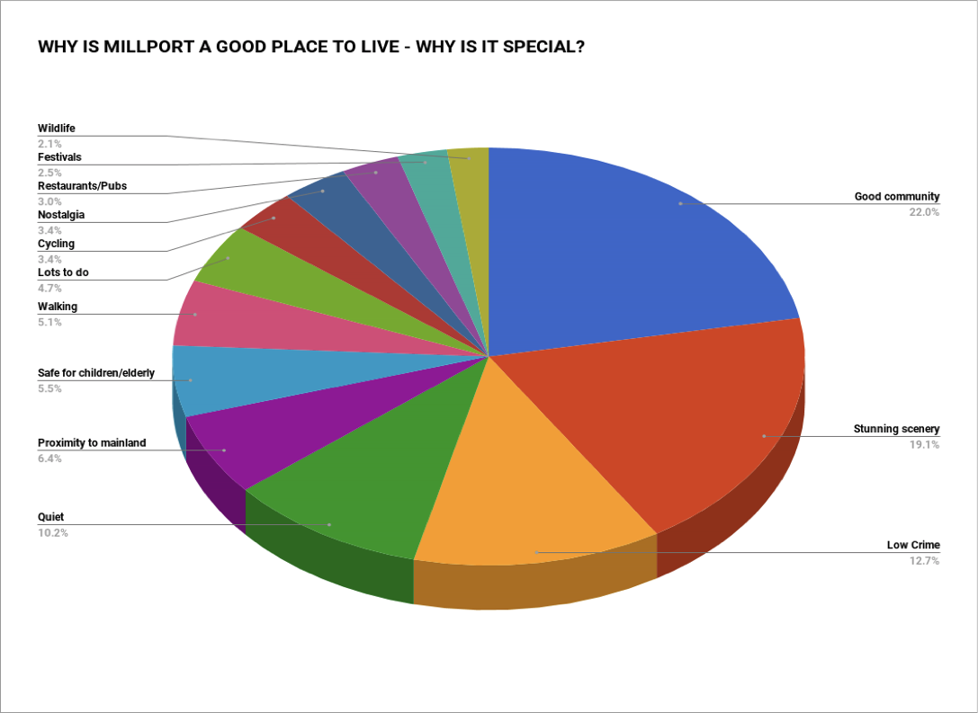

Slide 9
How can the economy of the island be improved for the benefit of the residents?
17.6% want a marina.
14.3% want to encourage some form of enterprise.
13.2% want some form of tourist event.

Slide 10
OTHER common COMMENTS
Maritime.
Marina, repair pier, pontoons, harbour charge.
Transport.
Car park, cycle path to ferry, Motorhome site, round island bus, fewer cars.
Ferry.
Service to pier, reduced resident fares, reduced trader fares, improved service, walkers and ornithologists to come on foot.

Slide 11
OTHER common COMMENTS
Shops.
Supermarket with lower prices, more shops. Convert shop to flat, encourage locals to shop locally.
Facilities.
Improved activities (all ages), more B&B, care homes, swimming pool.
Enterprise.
Encourage, more social, realisation of assets, support for business – apprentices/training.

Slide 12
OTHER common COMMENTS
Enterprise (contd.)
Gin or Whisky distillery, encourage more family festivals, more services for the elderly, apply for grants. multi purpose hall.
Entrepreneurs needed to revitalise the place, outdoor gym, become more self sustainable wet weather facility, financial support for businesses to stay open.
Tennis courts, economy about residents and not just businesses.
Alternative therapies, capitalise on day tripper visits. toilets/facilities/amenities, improved Housing for all ages, encourage new residents of all ages.

Slide 13
OTHER common COMMENTS
Tourism.
Make tourists more welcome, tourist events, groups on the island work together.
Luxury resort open all year, high end hotel, high end restaurant.
Make season longer, clear up untidy sites.
Beware large events which produce profits for individuals to the detriment of the island.
Long not short term fixes needed.

Slide 14
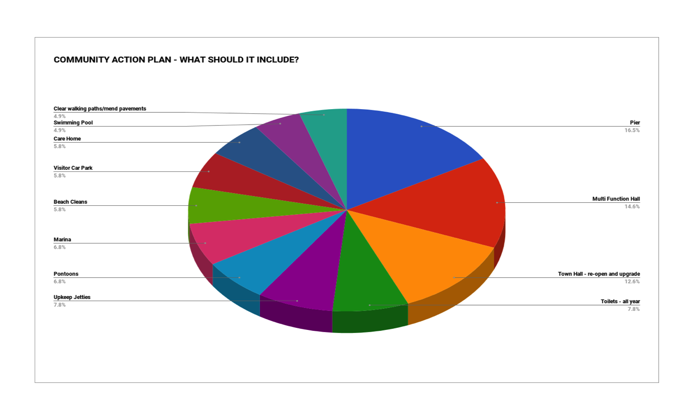

Slide 15
What should a Community Action Plan include?
16.5% want a pier.
14.6% want a multi purpose hall.
12.6% want to rescue the Town Hall.

Slide 16
“COMMUNITY SPACE IS NEEDED WHICH IS MULTI PURPOSE AND FLEXIBLE”
“WE ARE SURROUNDED BY WATER AND SOME OF THE BEST SAILING WATERS IN THE UK AND EUROPE. THE GREATEST OPPORTUNITY FOR ECONOMIC GROWTH COMES FROM THE PROVISION OF A MARINA AND IMPROVING MARINE FACILITIES”
“THE TOWN HALL NEEDS REPAIRED TO ALLOW LOCALS AND VISITORS THE USE AGAIN OF THIS SORELY MISSED VENUE”

Slide 17
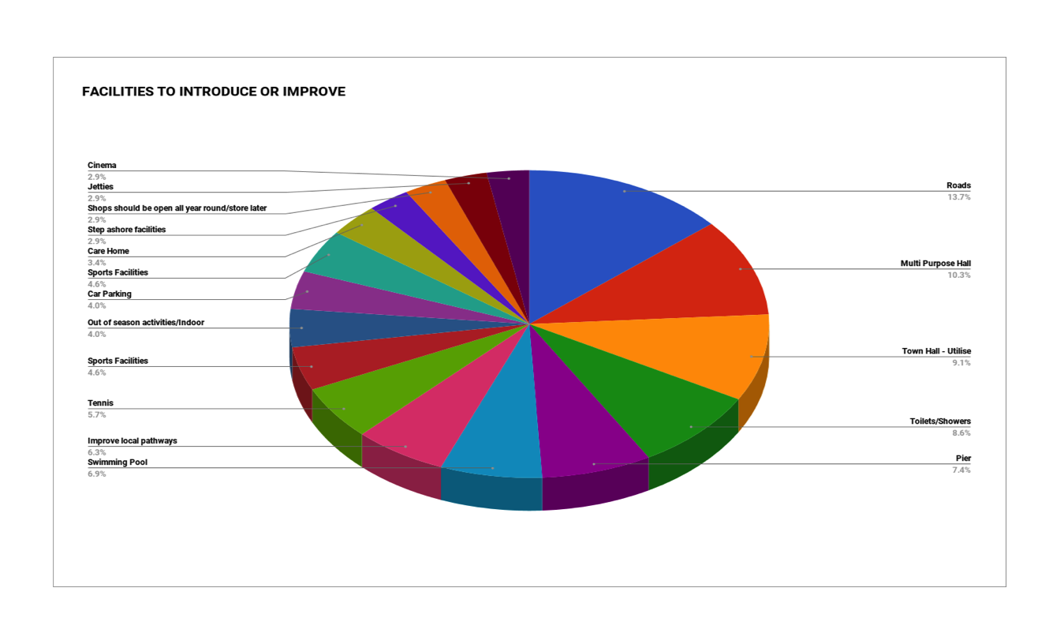

Slide 18
What facilities need improving or introducing ?
Roads = 13.7 %.
Multi Purpose Hall = 10.3%.
Rescue Town Hall = 9.1%.

Slide 19
Other common COMMENTS
Sports.
Tennis, boat trips, badminton, horse riding, mountain bike tracks, fishing.
Water sports, swimming pool, lights, seasonal golf camp.
Transport.
Roads, car parking, speed limits/20’s plenty, more public transport, “dial a bus”.
Cycle path, repair ferry off warning lights, boat trips to Wee Cumbrae.

Slide 20
Other common COMMENTS
Facilities.
Utilise Town Hall, toilets/showers, care home, out of season indoor activities, cinema, front.
Multi-purpose hall, pier, café at slip,marina, petrol station.
Garrison House
Grounds for residents not festivals, remove inflatables in Garrison Grounds, permanent camping/showers in Garrison, improve Garrison Grounds.
Make the Garrison provide what the people want, fairground to back of Garrison/tennis courts to front.

Slide 21
Other common COMMENTS
Tourism
Improve local pathways, more small scale festivals, Celtic music festival, fewer festivals, walks/wild life talks/day trips .
Arts and craft fairs, history/geology walks, town walks, model boating, country/falconry show, themed holidays.
Ferry
Later ferries, better ferry service, keep bus on when ferry cancelled.

Slide 22
Other common COMMENTS
Community
Central Community Hub, more community consultation, community hub for all ages, new putting green on front.
Stop organisations doing things for their own benefit instead of for the Community.
Services
Dump/recycling site, better Broadband, street lighting, better island drainage.
Infrastructure
More housing, local tradespeople, houses for over 55’s with clubhouse, jetties/pontoons.

Slide 23
General comments
Clear up the dog mess, stop Social Care people being housed here, Resident GP, shops should be open all year, more kids entertainment to encourage families.
Re-instate Kames Bay toilets, community meal sharing for all ages, youth activities, Screen Machine more often, better understanding of Hunterston decisions.
Ban non resident cars, limit visitor car numbers, charge for parking on the sea front.
Camp site/Glamping, sort out pavements, get rid of plastic flowers tied to benches, we need a Theatre.

Slide 24
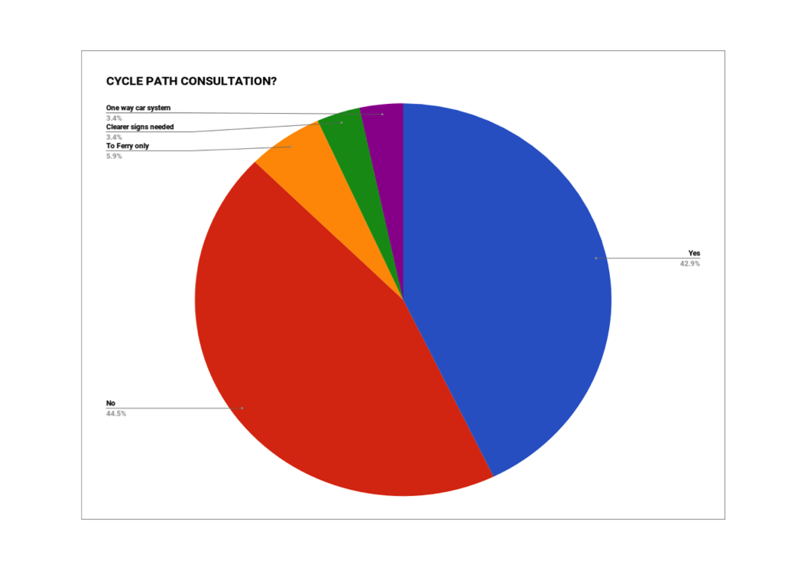

Slide 25
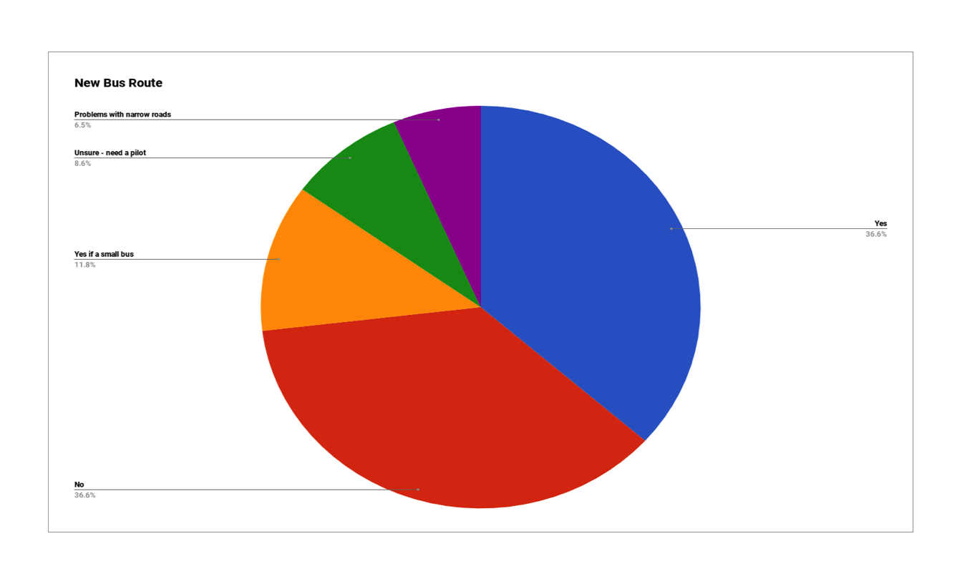

Slide 26
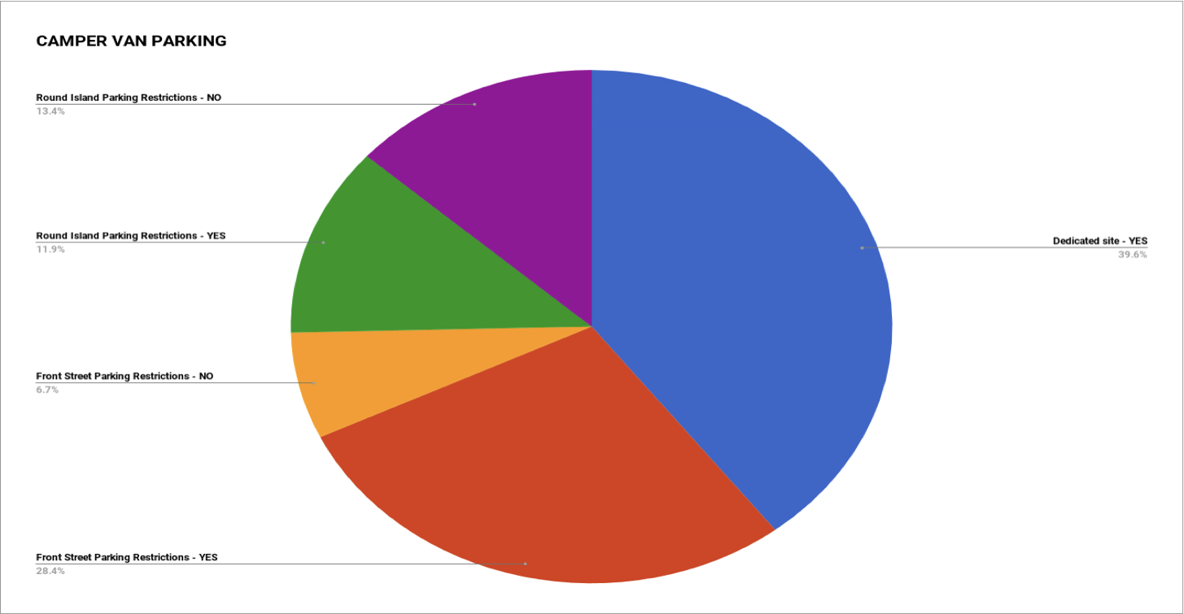

Slide 27
WHY IS MILLPORT SPECIAL?
Community, scenery, safe/low crime.
HOW CAN THE ECONOMY OF THE ISLAND BE IMPROVED FOR THE RESIDENTS?
Marina, encourage enterprise, tourism events.

Slide 28
FACILITIES TO INTRODUCE OR IMPROVE ?
Roads , multi purpose hall, rescue Town Hall.
CYCLE PATH CONSULTATION?
No = 44.5 % Yes = 42.9%
+ Clearer Signs Needed/To Ferry Only/One Way Car System.
COMMUNITY ACTION PLAN – WHAT SHOULD IT INCLUDE?
Pier, multi purpose hall, rescue Town Hall.

Slide 29
NEW BUS ROUTE?
Yes, to include a small bus = 48.4%.
No, to include roads too narrow= 43%.
Unsure, need a pilot = 8.6%.
CAMPER VAN RESTRICTIONS ?
Yes – on front street = 28.4%.
Yes - around the island = 11.9%.
No – around the island = 13.4%.
Dedicated” pay for” site = 39.6%.

Slide 30
NEXT STEPS???
1. Possibly form a community action group. We already have offers of help from two holiday home owners and several indications from residents.
Possibly write a community action plan – for small up to large scale projects.
Anyone is welcome to email CumbraeCcouncil@gmail.com if they wish to have an electronic version of this presentation.

Slide 31
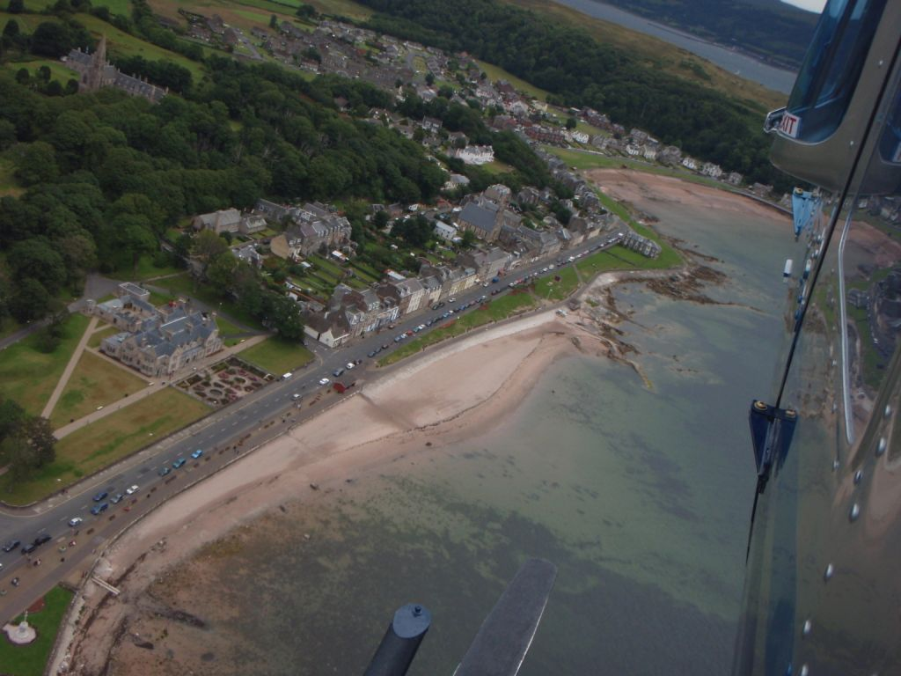
Questions ?
Thankyou for your support …..and goodnight.

